Slide 1
MOVIE BOOKING SYSTEM
TEAM 08
SUB:
DBMS
DATE:
09-05-2023

Slide 2
ABSTRACT
Movie Booking System is a project that focuses on the fundamental operations of a movie theatre. We were required to create a theatre operator system database for this coursework, which could store all the information required in a theatre. The system's functions include customer login, access to movie information, the ability to order cinema tickets, etc.
There could be more than one film playing in a theatre. It operates on various days and times. Monitoring regular updates or which movies are no longer showing in theatres is difficult. The theatre management System was created to get around these limitations.

Slide 3
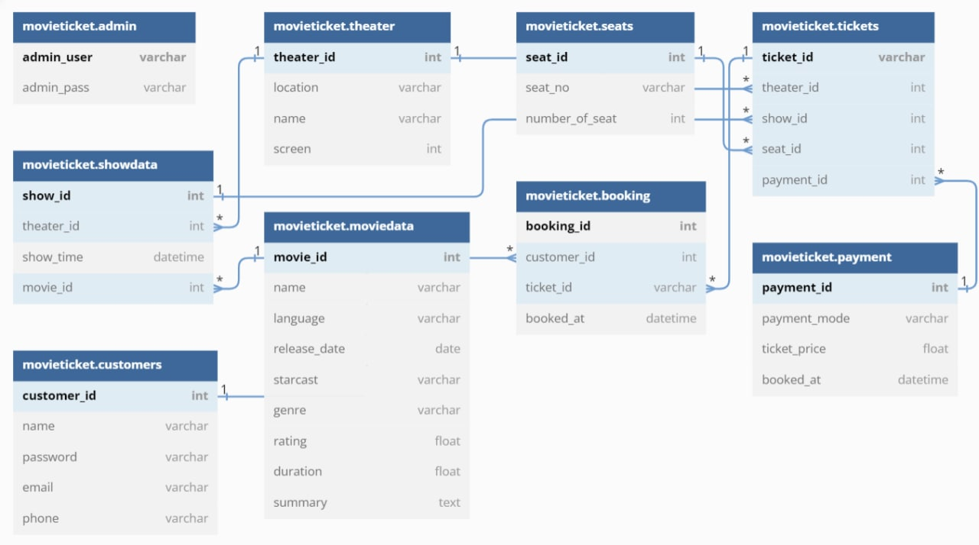
SCHEMA DESIGN

Slide 4
SOFTWARE REQUIREMENTS
ORACLE DATABASE 11G | ORACLE SQL DEVELOPER | PYTHON
HTML | CSS | JAVASCRIPT
 | TORNADO

Slide 5
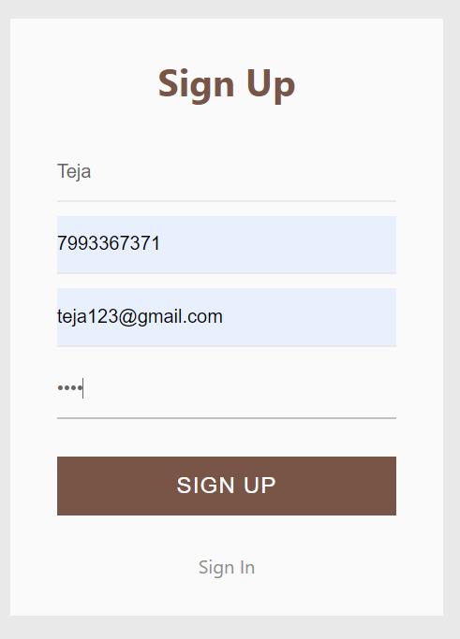
SIGN-UP PAGE
INTERFACE

Slide 6
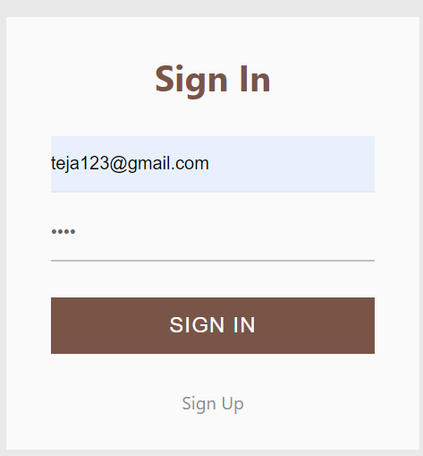
SIGN-IN PAGE

Slide 7
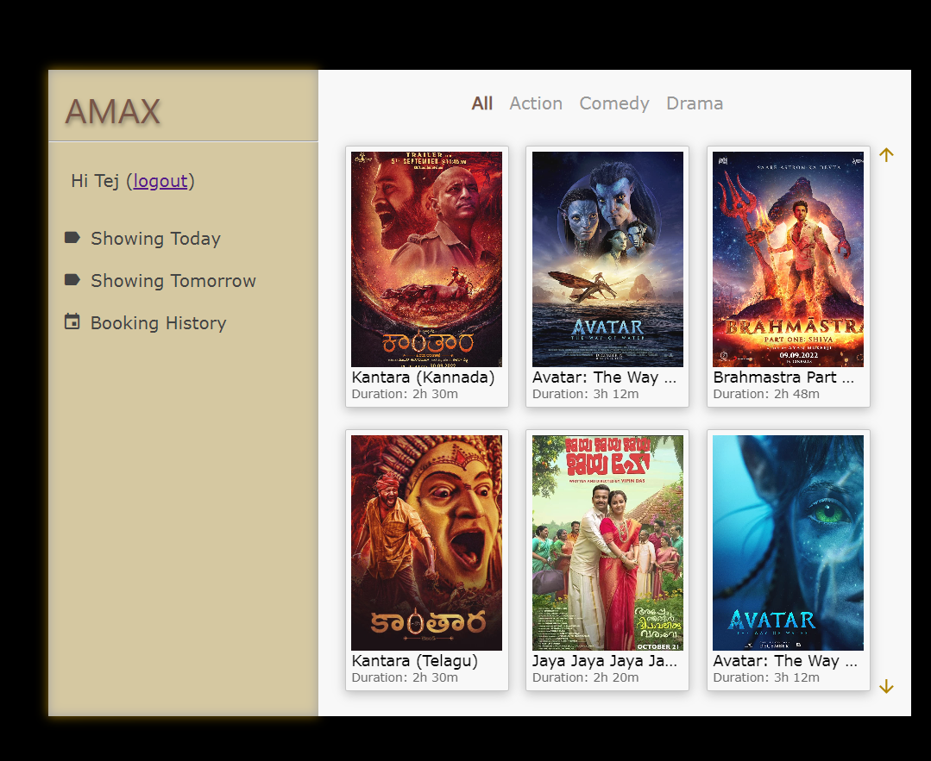
HOME PAGE
HOME

Slide 8
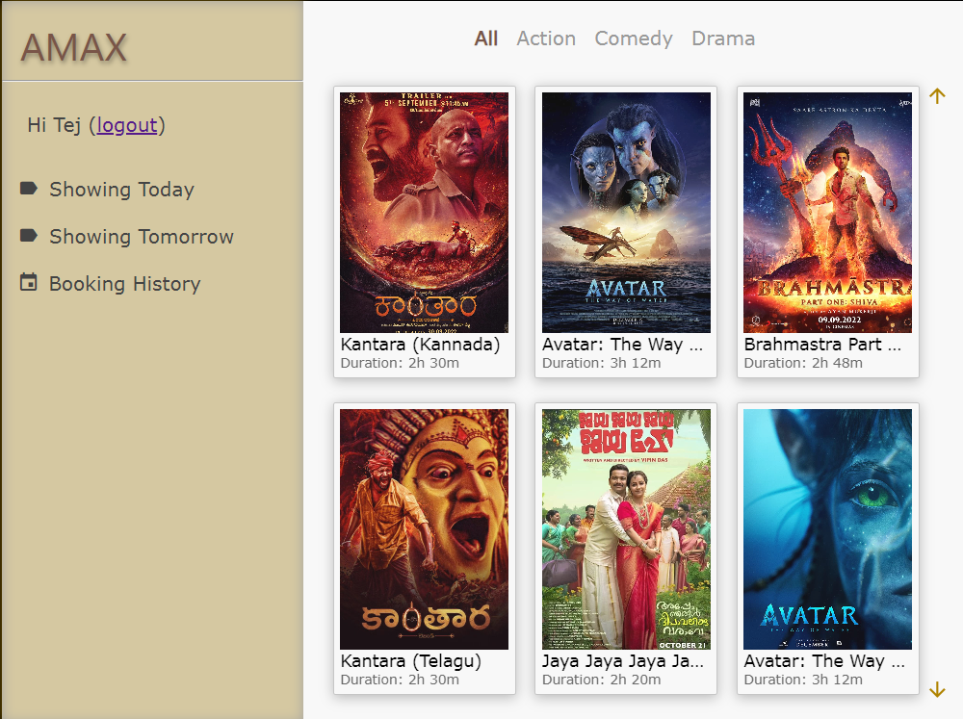
TICKET BOOKING
FILMS OF THE DAY

Slide 9
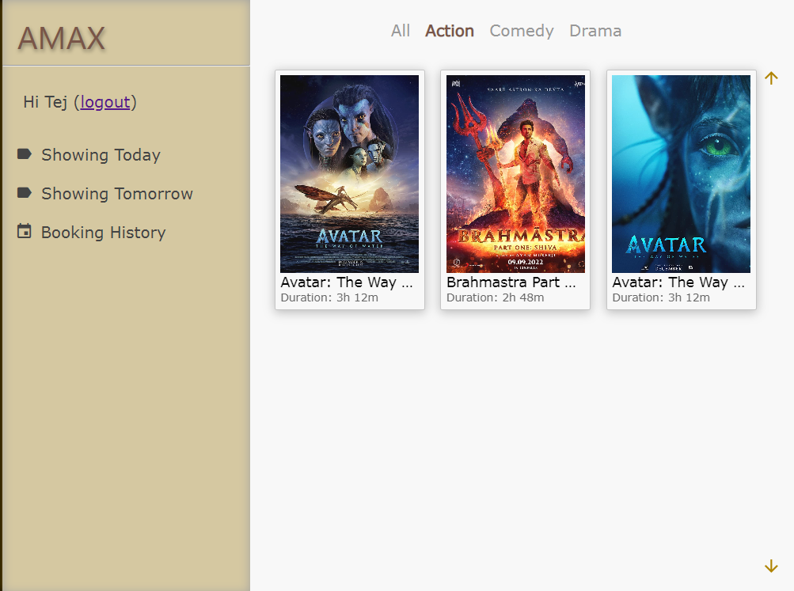
GENRE
ACTION

Slide 10
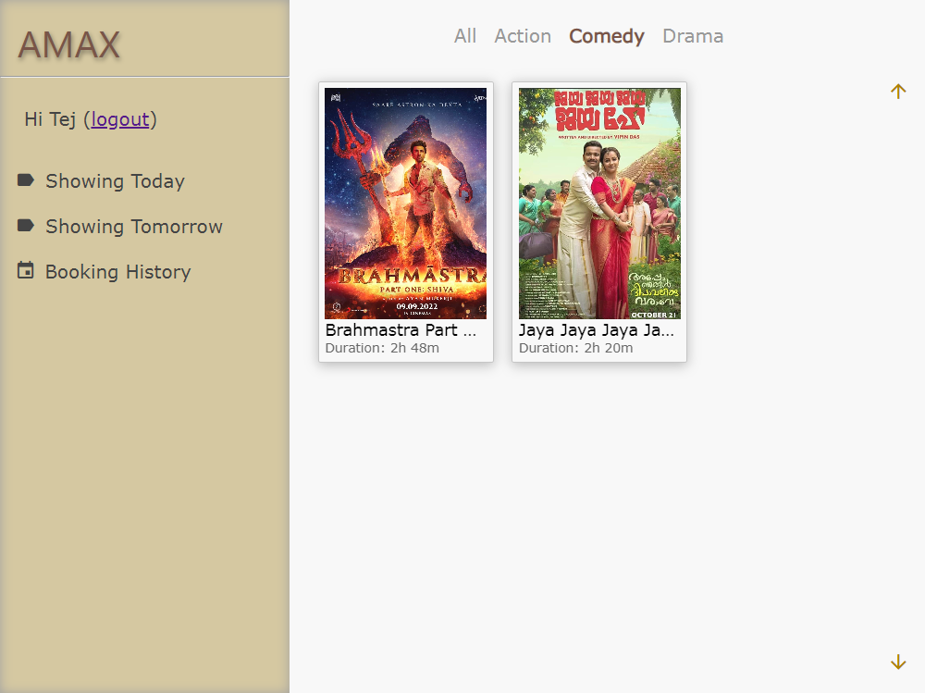
GENRE
COMEDY

Slide 11
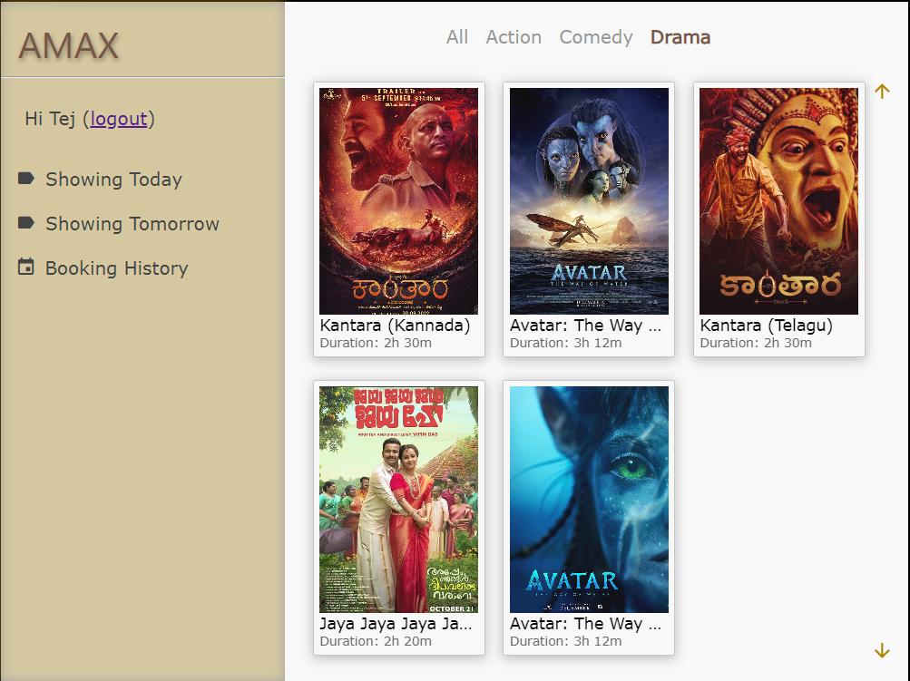
GENRE
DRAMA

Slide 12
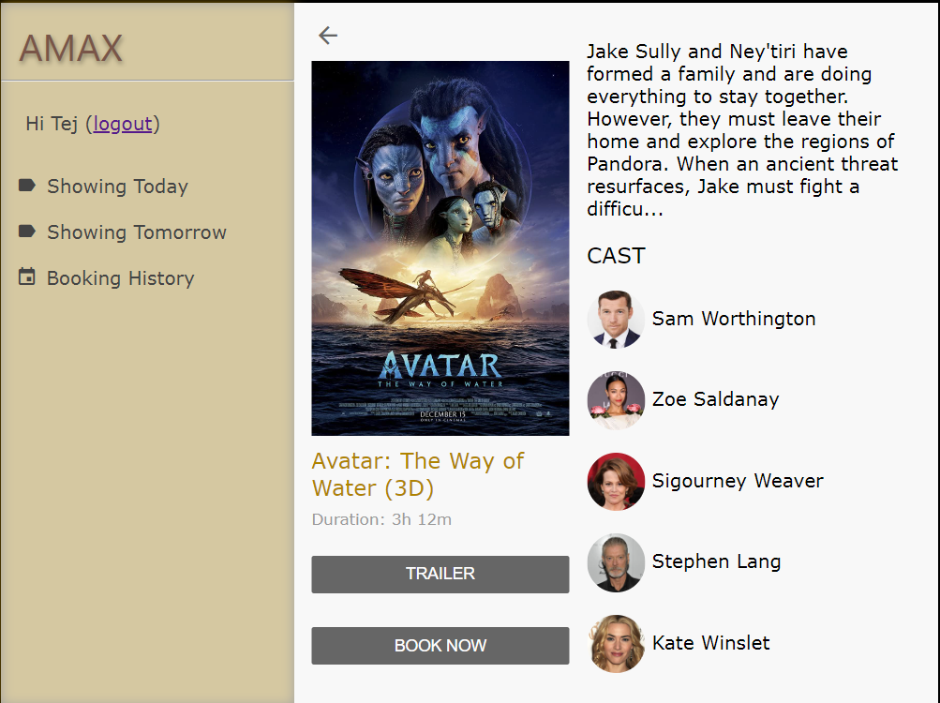
INTERFACE

Slide 13
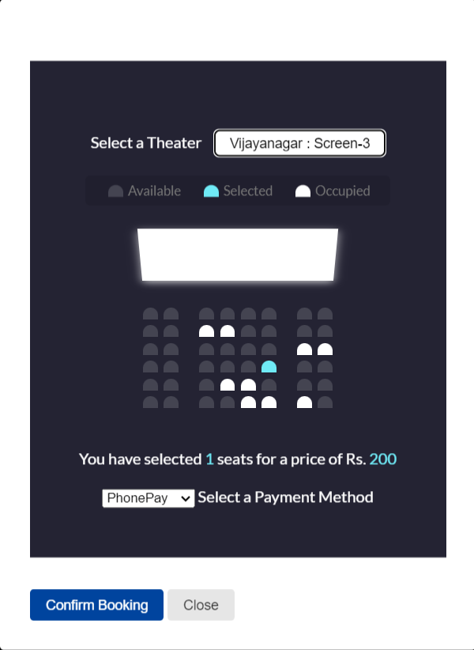
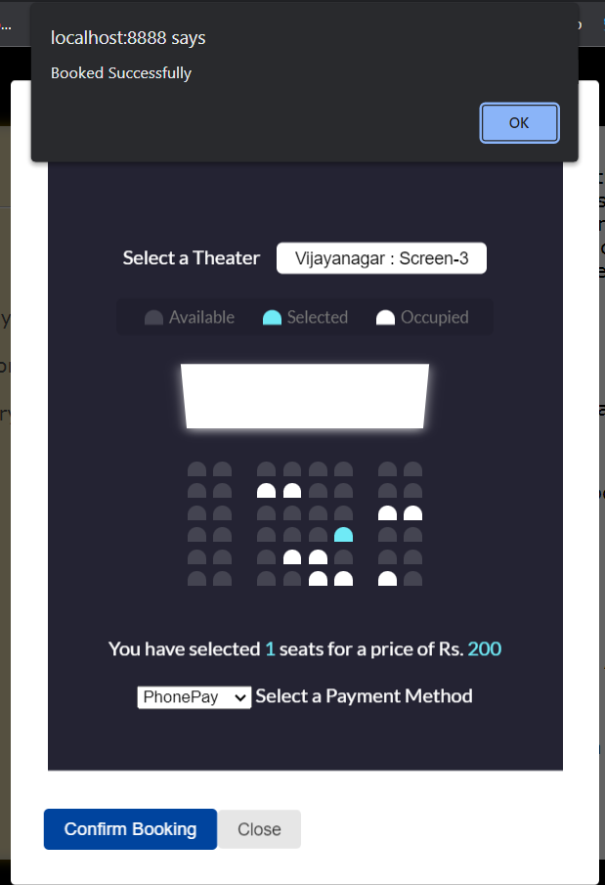
SELECTING SEATS

Slide 14
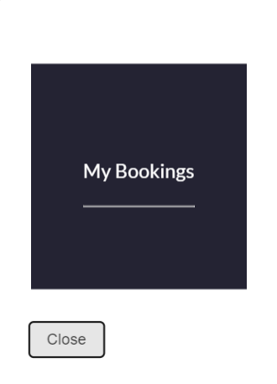
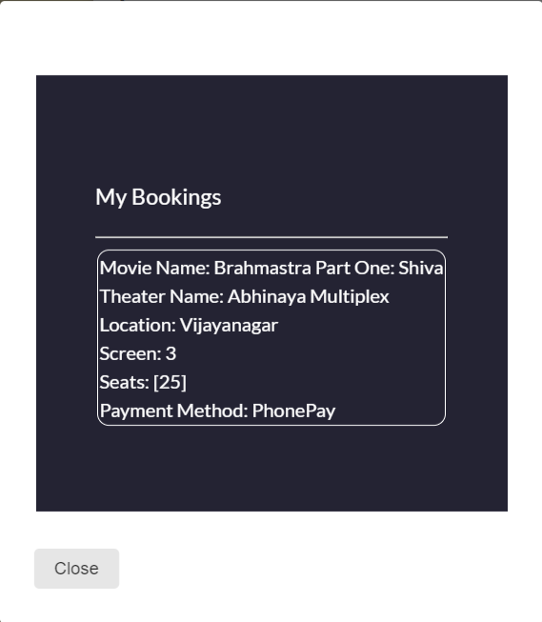
BOOKING HISTORY

Slide 15
THE END

